Slide 1

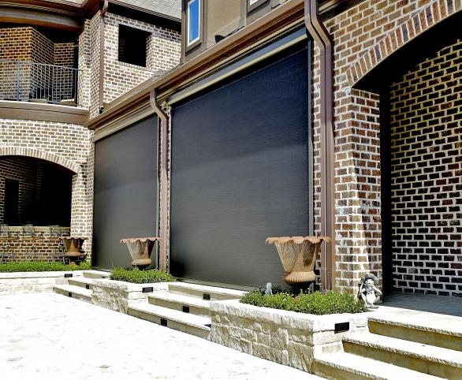
H4800 Webinar
(855) 488 7655
miragescreensystems.com
T
W

Slide 2
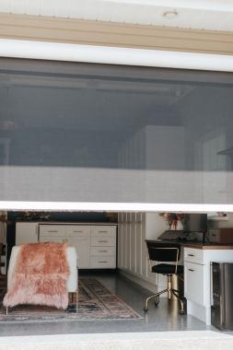
Today’s agenda
01.
Introducing the Product
Going through the order form
02.
Cost / Pricing Guideline
03.
Installing the Product
04.
Tips and Tricks

Slide 3

Product Basics

Slide 4
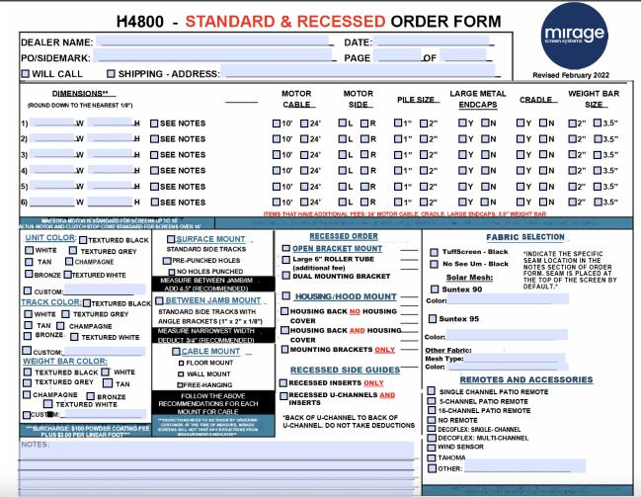
The H4800 Order Form - Colors

Slide 5





H4800 Colors
Textured Black
Bronze
Champagne
Tan
Textured White
White
Textured Grey

Slide 6
The H4800 Order Form - Sizing

Slide 7
H4800 Sizing
Maximum Width = 22 feet (deflection beyond 16 feet, consider using cradle and large metal end caps)
Somfy motors:
  Maestra – up to 16 feet
  Altus – 16 to 22 feet
Motor placement – to closest power source. (determine by facing the front of the housing)
Power – Plug in or hard wire (plug supplied).
Electrical – 110Volts, draw of max. 3amps.
1” or 2” pile – 2” used if unlevel bottom surface.

Slide 8
H4800 Order Form – Mounting Types

Slide 9
H4800 Mounting Types
Surface
In-Jamb – need L/angle brackets
Recessed – need u-channel
Make your own allowances - we build what you order.

Slide 10
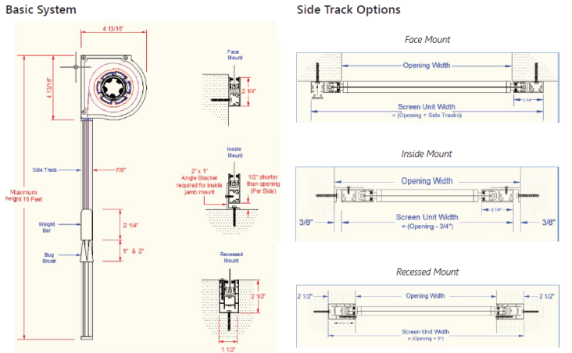
H4800 Mounting Types

Slide 11
H4800 Order Form – Remotes

Slide 12
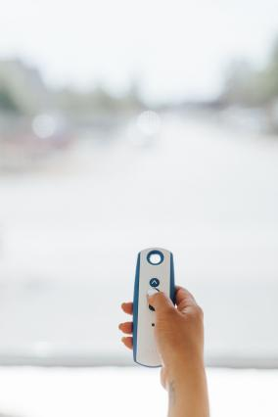

H4800 Remotes
1,5,16 – channel
Decoflex by
Tahoma by

Slide 13
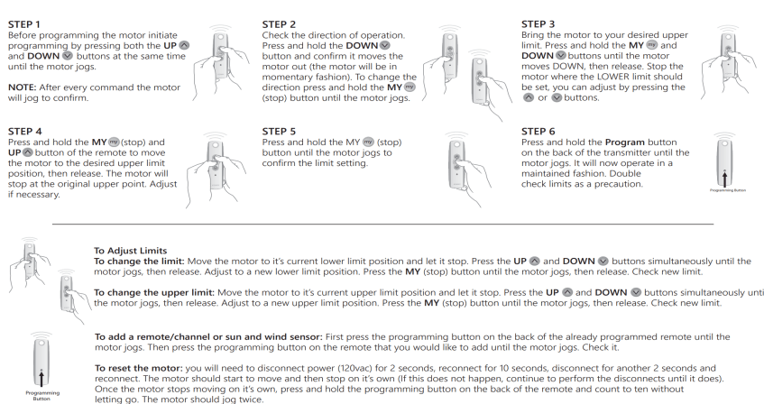
H4800 Remotes - Basics

Slide 14
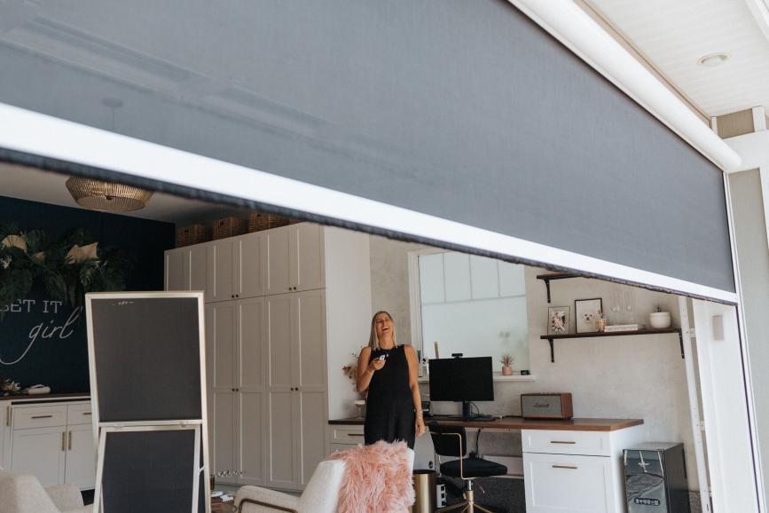
H4800 Fabrics

Slide 15
H4800 Order Form - Fabrics

Slide 16
H4800 Fabrics
Insect
Solar (about $50 more per unit than insect)
Privacy
Vinyl
Blackout
*We can source any fabric, ask your TSM

Slide 17
H4800 Order Form – Motor

Slide 18
H4800 - Power Cords
Antenna is in the first two feet of the cord
The cord is white, plug is black
10’ to 24’ lengths available

Slide 19
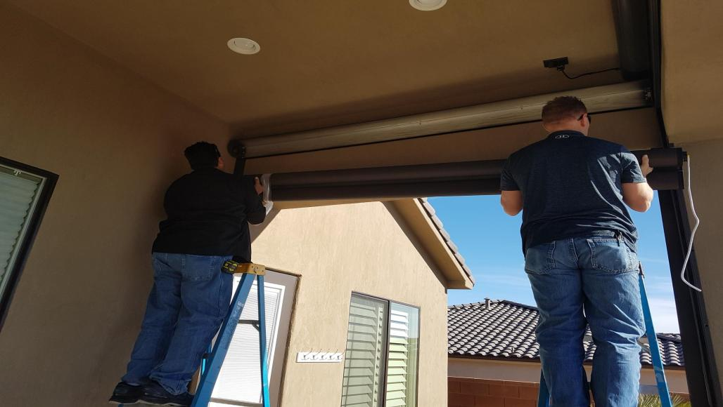
Installation

Slide 20
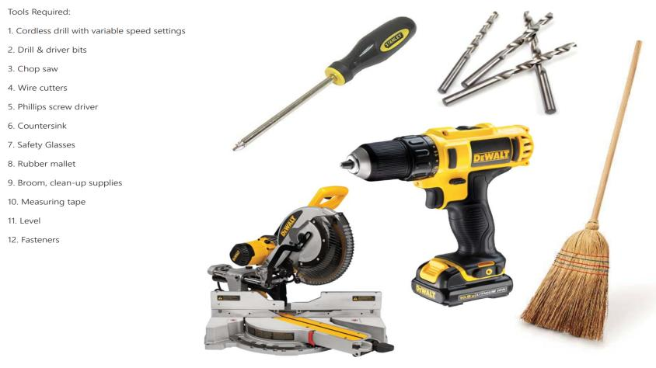
Tools of the Trade

Slide 21
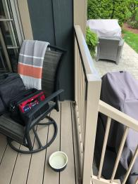
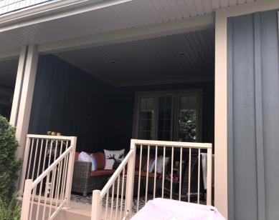
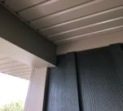
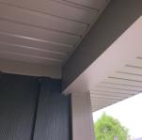
H4800 – Pre – install Photos
Corner shot high
Corner shot low:
Overall shot:

Slide 22
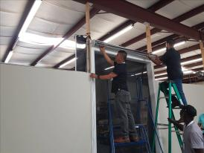
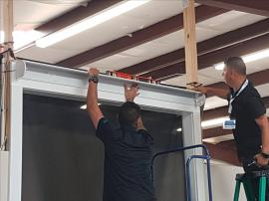
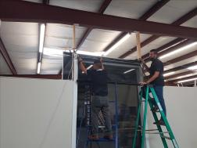
H4800 – Order of Standard Install
Step 2: Drop in roller tube
Step 1: Mount back of cassette
Step 3: Center & attach screen to roller tube
Detailed install instructions are found in H4800 Module 2 on the Mirage web store.

Slide 23
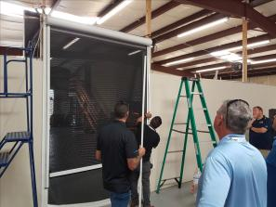
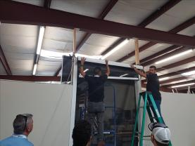
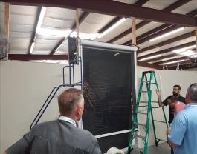
H4800 – Order of Standard Install
Step 5: Mount side tracks
Step 4: Test fit front of cassette
Step 6: Set remote limits

Slide 24
Tips and Tricks
A level cassette is key – future problems occur otherwise
Plan/know power source location before ordering – manage customer expectations
Piece of mesh to correct unbalanced weight bar (this is called shimming)
Center mounting under header – hood access a consideration
Pigtail the cord
Antenna
Cord color
Single power for each unit – for programming
Be aware of weight bar clearance – width and height
Order L-brackets to rounded up foot
Open your box before you go to site
Bring two ladders – adequate height
Cut side tracks from bottom end

Slide 25
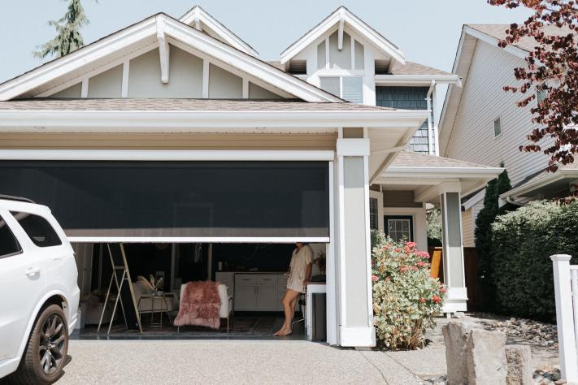
Questions??

